Slide 1

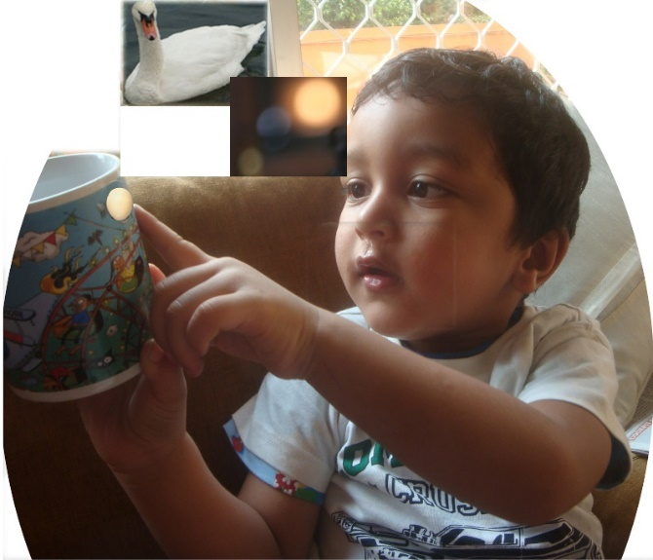
Developing Intuitive Faculty and Genius
Attitude for Success Part 3
Developing Genius
Through Synergy of
Analytical and Intuitive Faculties
P.K.Ratho
Everybody is born ‘genius’ with Pure Consciousness as at birth. It is from Pure Adult ego, Sat-tva, that is, ability to know reality. A genius knows correctly and totally.
True knowledge develops when a vision of the object arises in crystal clear mind with Pure Adult ego from deep meditation.
Control Mind (Samyama) Consists of -
Concentration of Mind
Pratibhat Va Sarvam
Meditation
Intuitive True Knowledge
Can Training Enable to Develop
Intuitive Faculty and Genius?
Yes!
Knowhow (Introduction) follows!
‘Genius’ originates from Latin, ‘genero’ meaning ‘give birth to’ (create new).

Slide 2
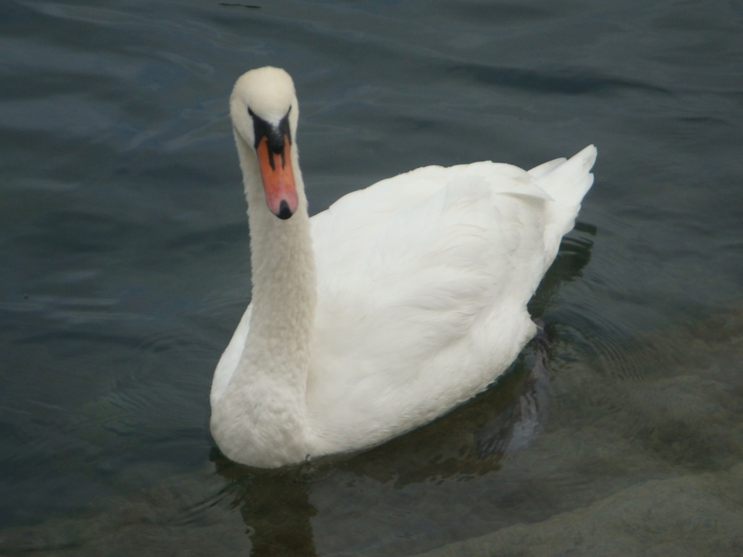
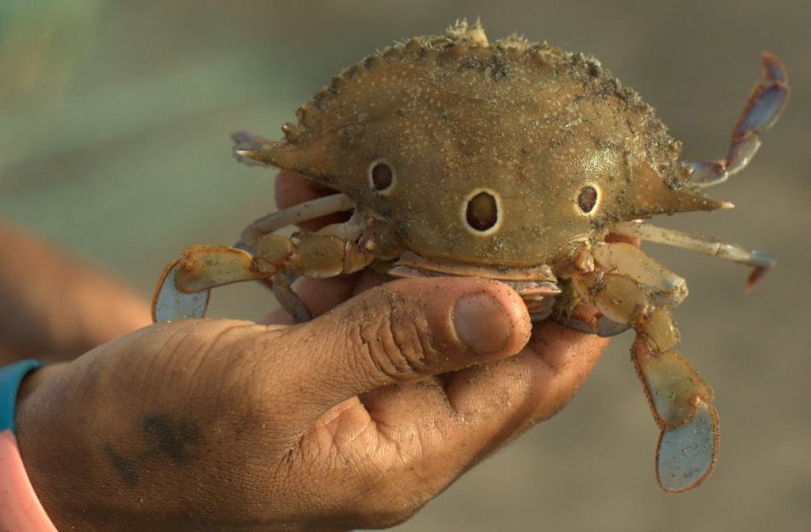
Minimising Negative Attitudes and
Developing Concentration of Mind and Meditation
Interest focuses attention and ignores distractions; helps concentration of mind
Successive refinement of action and meditation to develop intuitive true knowledge
False knowledge is the root cause of negative attitudes. Minimise by opposite thought (Pratipaksa Bhavana). A person acts as he thinks. Success follows.
Concentration of mind is by focusing attention for at least half-a-minute. Initially it should be on the object of interest; helps to ignore distractions.
Breath-control (Pranayama) helps concentration of mind.
Meditation is uninterrupted concentration of mind for at least half-an-hour. In successive stages, mind becomes clearer until true knowledge develops in crystal-clear mind.
True knowledge is from action (logic), meditation (reflection), joyful discovery and internalisation. It is through meditation on the physical, characteristics, subtle nature and purpose of the object.

Slide 3
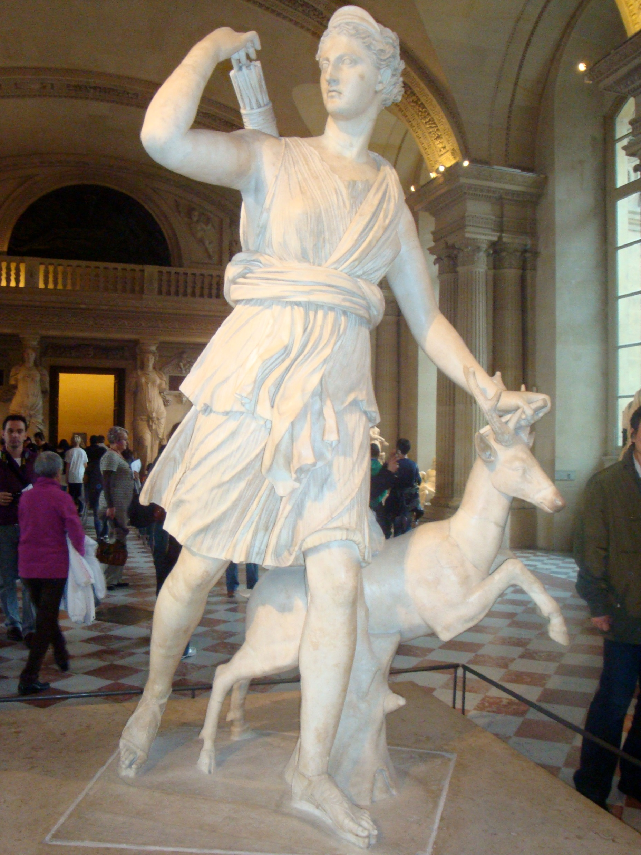

Developing Intuitive Faculty and Genius
Supernormal Perception By
Functional Perfection of Senses
Genius By Raising Level of Intuitive Faculty
True knowledge is by insight from iterative refinement of action with meditation.
Functional perfection of a sense is through successive refinement of action and meditation on its interaction with causal basic element. Self-discipline is prerequisite.
Functional perfection of senses makes perception true and supernormal. Such a person is a genius.
Genius has a crystal-clear mind and Pure Consciousness as at birth (Prativa). By knowing cause-and-effect a genius develops synergy of intuitive faculty to generate alternative solutions and analytical faculty. He creates something new.
Innovation is by providing the small missing link, such as in Value Engineering. Nature is a good source. Focus on the eternally true (Rta) cause-and-effect relation.

Slide 4
Model of Entrepreneurship (Genius) for Success
Model: Software
Input: Degrees of activities
‘Glossary’ in the manual / ‘Help’ menu of software ensures correct input of degrees of activities.
Synergy of body and the mind; of the team; and of analytical and intuitive faculties are marked along three axes of model.
Inputs are marked as degrees of activities. Outputs are results of activities.
Model gives the knowhow to develop attitude for success through entrepreneurship (synergy of the three synergies).
Output:
Profile of Needs / Motives;
Profile of Egos / Attitudes
Professional Personality
Mental Blocks and their Removal
Activities to Develop Synergy of -
Body and Mind
Team
Analytical and Intuitive Faculties
.
Genius
Synergy for Success: Entrepreneur
Synergy of
Body and Mind
For further information and online training: Contact us: 1. www.buildbestvalues.com
2. P.K.Ratho, 0674-2951703 (M) 9437490303
Synergy of
Team

